Slide 1
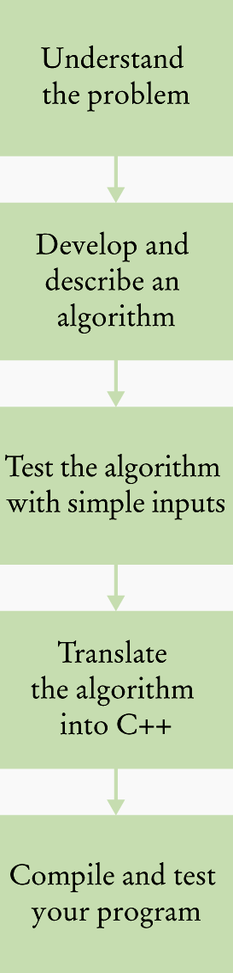
The Software Development Process
For each problem
the programmer goes through these steps

Slide 2
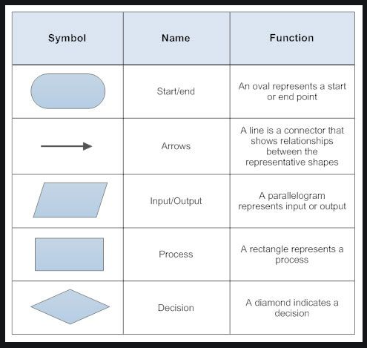
Flowchart symbols
C++ for Everyone by Cay Horstmann
Copyright © 2008 by John Wiley & Sons. All rights reserved

Slide 3
Describing an Algorithm with Pseudocode
Mom said: Johnny, please go to the market and buy a bottle of milk and if they have eggs, buy 6

Slide 4
Describing an Algorithm with Pseudocode
Mom said: Johnny, please go to the market and buy a bottle of milk and if they have eggs, buy 6 more bottles of milk
Draw a flowchart for the instructions above

Slide 5
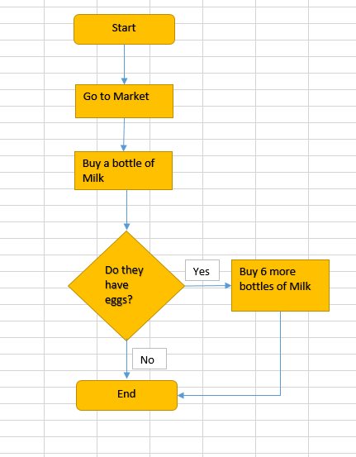

C++ for Everyone by Cay Horstmann
Copyright © 2008 by John Wiley & Sons. All rights reserved

Slide 6
Describing an Algorithm with Pseudocode
Mom said: Johnny, please go to the market and buy a bottle of milk and if they have eggs, buy 6 eggs
Draw a flowchart for the instructions above

Slide 7
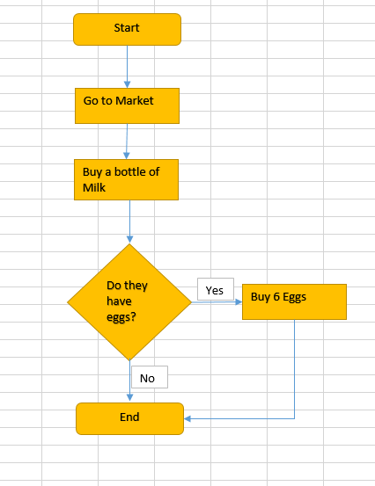
C++ for Everyone by Cay Horstmann
Copyright © 2008 by John Wiley & Sons. All rights reserved

Slide 8
Recap
- A computer program is a sequence of instructions and decisions provided to the computer
- Can be written in a variety of languages

Slide 9
Types of Programming Language
There are three types of programming language:
– Machine language (Low-level language)
  – Assembly language (Low-level language)
  – High-level language
Low-level languages are closer to the language used
by a computer, while high-level languages are closer to human languages.
C++ for Everyone by Cay Horstmann
Copyright © 2008 by John Wiley & Sons. All rights reserved

Slide 10
Low Level Languages
Machine Language
- a programming language that is interpreted & executed directly by the computer
- written as strings of binary 1’s and 0’s
- Machine dependent

Slide 11
Low level Language
Machine Language
Machine dependent
Difficult to program and write
Prone to errors
Difficult to modify

Slide 12
Low level Language
Assembly Language
- a symbolic language with an instruction set that is basically 1-1 with the machine language
- Requires a translator known as assembler to convert to machine language

Slide 13
Advantages - Low level Language
Takes up less space
Runs faster
Useful for writing system programs

Slide 14
High level Language
- machine independent language
- written using a language which resembles English words and familiar mathematical symbols
- Each statement is equivalent to several machine level instructions
- Requires a compiler to translate into machine language

Slide 15
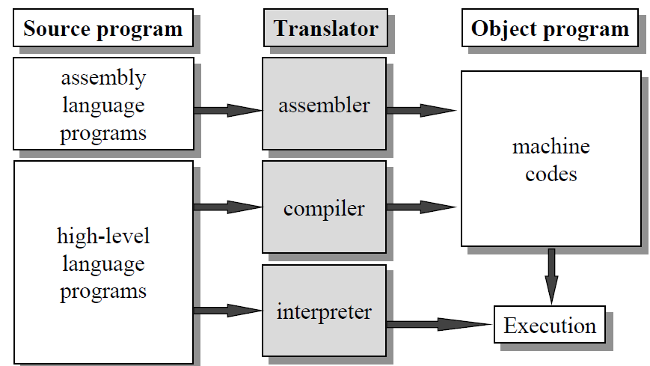

Slide 16
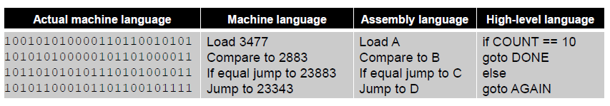
Example

Slide 17
Example
Example:
Machine language : 10110000 01100001
Assembly language : mov a1, #061h
Meaning: Move the hexadecimal value 61 (97 decimal) into the processor register named "a1".
C++ for Everyone by Cay Horstmann
Copyright © 2008 by John Wiley & Sons. All rights reserved

Slide 18
High-Level Languages and the Compiler
High-level languages like C++ are independent of the processor type and hardware. They will work equally well:
  on an Intel Pentium and a processor
  in a cell phone
The compiler
  a special computer program, that translates the higher-level description (a program) into machine instructions for a particular processor.
Low-level language: the machine code for a specific CPU
  the compiler-generated machine instructions are different, but the programmer who uses the compiler need not worry about these differences.
C++ for Everyone by Cay Horstmann
Copyright © 2012 by John Wiley & Sons. All rights reserved

Slide 19

The Evolution of C++
Ancient history (pre 1972)
C (1972)
ANSI Standard C (1989)
Meanwhile, Bjarne Stroustrup of AT&T adds features of the language Simula (an object-oriented language designed for carrying out simulations) to C resulting in:
C++ (1985)
C++ for Everyone by Cay Horstmann
Copyright © 2012 by John Wiley & Sons. All rights reserved

